Slide 1
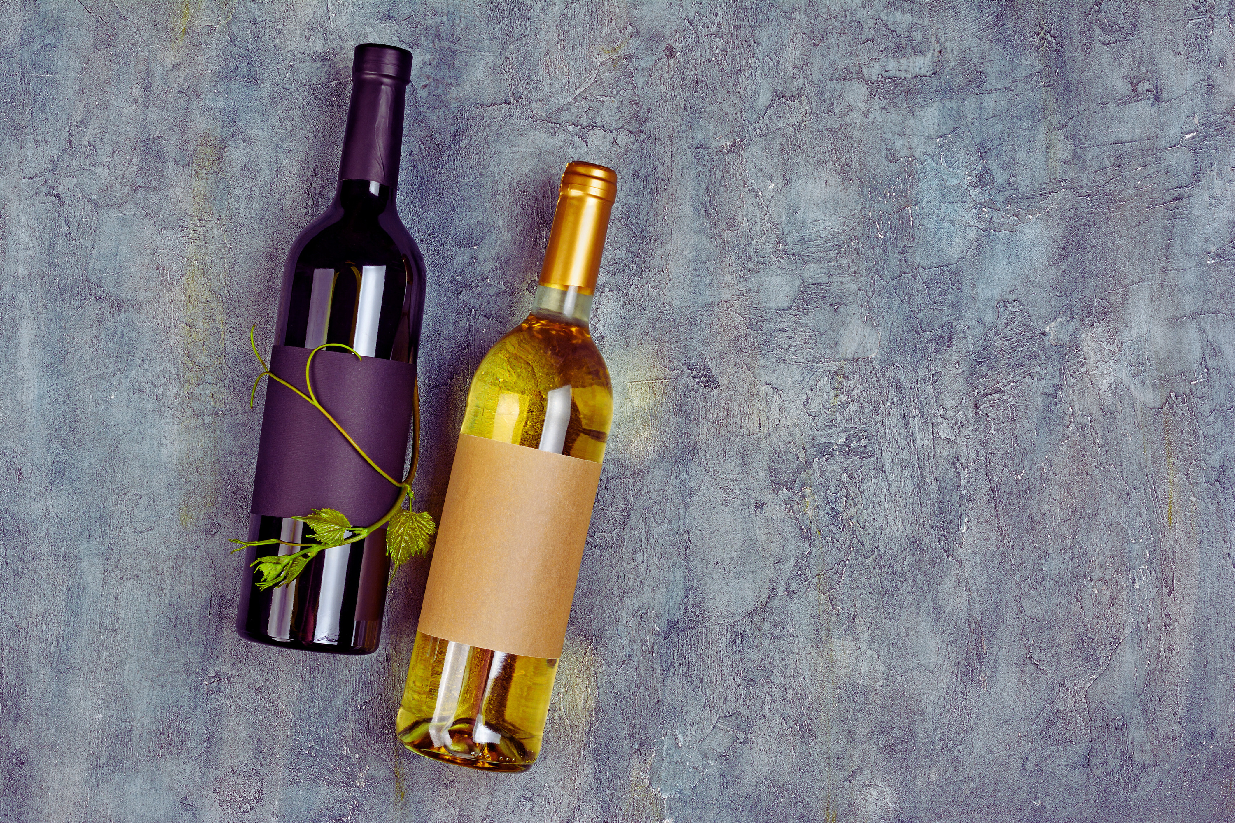

Magnifique Lux Wines.
Tangy Sweet, Dark, and Juicy!
Comm 600: Communication for Leadership
Prof. Boyer
3/15/2024
By Wynter Aiken

Slide 2
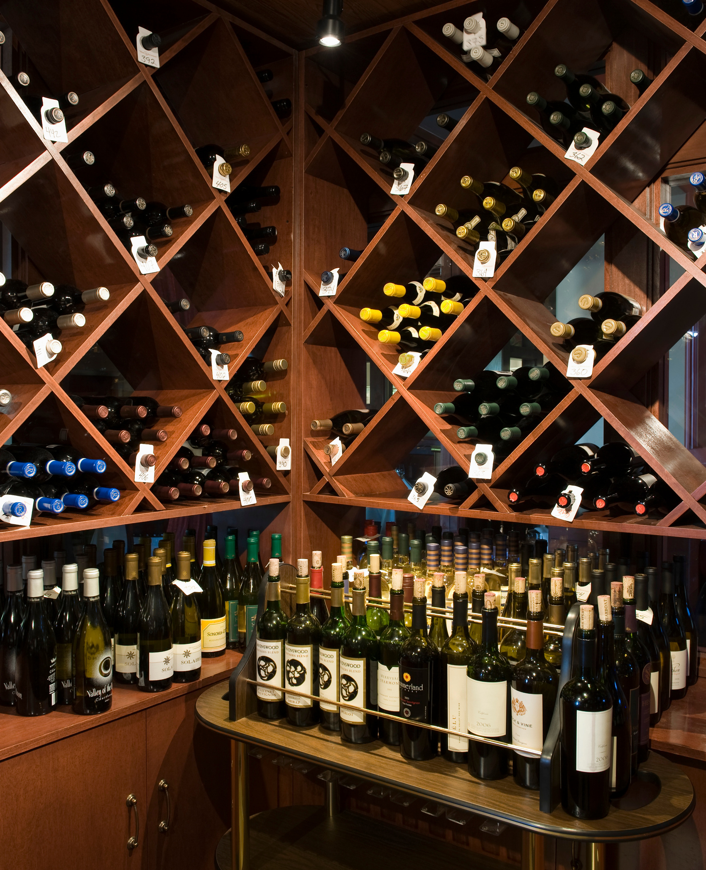

Global Taste. Domestic Creation.
Welcome to
Magnifique Lux Wines
Magnifique Lux Wines is committed to producing high-quality wine that is sustainable and affordable for all consumers. With the opening of our new storefront in the Republic of Georgia, we aim to increase our passion, work ethic, and goal-oriented approach to tasty sweet excellence.
CEO & CO-FOUNDER OF MAGNIFIQUE LUX WINES
United States Manufacturing
www.magnifiqueluxwines.com

Slide 3

About Our Company
History of
Magnifique Lux Wines
Established 2005
The Story About Our Journey
Our story began in the spring of March 2005 when Magnifique Lux Wines opened its doors to all who wish to be swept away by the flavors of the valley trees, the musk of grapes, and the sweetness of nectar. Despite the competitive market, we found a new home in the Republic of Georgia. This country has always been proud of its white and dark grape wines, including Saperavi red wine, Rkatseteli white wine, and Kindzmarauli semi-sweet red. Our wines are made with a balance of acidity, deep-rich color, floral aroma, and juicy grapes, taking inspiration from the multi-cultural traditions of Qvevri wine fermentation in the Georgian mountains (Levine, 2023, paras. 4-5) Our labels are in English, Georgian, Azeri, and Russian languages, featuring the purple grape, and we hope to grace the shelves of many homes, offices, and buildings for years to come.
Magnifique Lux Wines
Notes:
Although manufactured in the U.S., Magnifique Lux Wines is now being exported to different parts of the world, including the Republic of Georgia. This encourages us to continue bringing our sweet wines to your doorstep. We have recently adopted a new cross-cultural marketing strategy, where our new store serves as a pick-up and event-hosting location. We focus more on online sales through our interactive email brochure, newsletters, and 24/7 operating website. With this, we are thrilled to offer you luxury, sustainable, and affordable wines.

Slide 4
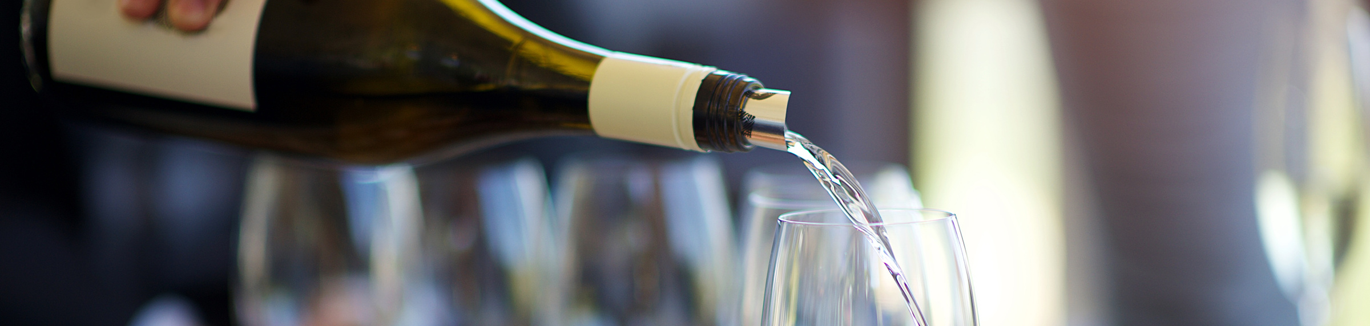
Vision
Mission
Goals
Imagine Magnifique Lux Wines when you grab wine off the shelf. We value patience in producing high-quality, luxurious wine, striving to spread love, smiles, and happiness in every sip.
Across the seas and through the mountains, Magnifique Lux Wines forms an everlasting bond with its consumers, who come from all walks of life.
Our wine isn't just in a bottle. It's consumed by our women and men through online purchasing, events, and celebrations, the active promotion of wine education across social media platforms, and successful collaborations with American and Georgian-based wine influencers, educators, and specialists.
Notes:
Our teams are filled with multilingual employees who work around the clock to ensure that all communication is honest, trustworthy, empathetic, and conducted with integrity (Cardon, 2021, p. 55).
"Learning another language can also help an employee better appreciate and accept other people's cultures and traditions. This capacity distinguishes between failure and success in a multicultural group, between a balanced work atmosphere and a stressful, problematic one" (Pop et al., 2022, p. 6, para. 2). Magnifique Lux Wines uses online and in-person marketing to reach a global consumer base. We understand that our customers expect top-notch customer service.

Slide 5


www.magnifiqueluxwines.com
Target Customers
New Wine Enthusiasts
Brides and Grooms
Besties and Bros
Long-Life Wine Connoisseur
Magnifique Lux Wines offers online and in-person wine educational classes to everyone who is interested in learning about the wine industry, whether you're a beginner or an expert.
Celebrate the love-filled union of you and your partner with a glass of shiny red or white Magnifique Lux Wines. To all the lovely couples out there, we want to celebrate your everlasting love with a taste-filled blessing. Are you interested in having our exclusive wedding package delivered just in time for your wedding day, bachelorette, or bachelor party? Don't hesitate to contact our 24/7 customer service for further details.
Magnifique Lux Wines offers a wide selection perfect for casual gatherings or lively night outs with the girls or guys.
Whether you've been drinking wine for only three years or for over 40 years, Magnifique Lux Wines has something to cater to your expert palate in sweet wines. Cruise through our website to find the best wines that can only hope to live up to your personal knowledge and expertise in drinking delicious wine.
Notes:
Experiencing another country allows us to appreciate their unique values, culture, language, and beauty. Georgia is a diverse nation with people of varied backgrounds, and we take pride in the fact that our wine is now available in a country that values tradition and natural wine-making processes.
The wine industry is booming, and our goal is not solely to establish profit but also to contribute to the already blooming economy. Our efforts in the United States and now in Georgia make our company a progressive brand.
In a 2019 CNN article, reporter Paul Rimple discusses how Georgia's wine industry has experienced a resurgence since the West adopted the macerated wine process called "orange wine." Georgians have used this technique since the establishment of wine-making (Rimple, 2019, para. 13).
Because of this, we have become interested in learning about Georgia's wine-making history and techniques to reach out to a new group of wine-loving consumers. We, as a co-culture (Cardon, 2021, p. 57), have set our sights on brides and grooms who want to celebrate the next chapter of their lives with a dark cherry red, new wine enthusiasts who are hoping to start their own company and brand, groups of friends who want to relax and sip under the cool winter breeze and the everyday wine lover who, after a long day of work, needs a sip to say "Ahh finally." According to Cardon (2021, p. 58), when establishing a company in another culture, showing respect and embracing all it offers can allow more opportunities to gain new clients, consumers, and partners. Wine has no definite age limit because time and age cease to exist in every sip.

Slide 6



Marketing Online and In-Person
MONDAY-FRIDAY SCHEDULING
Wedding and Bridal Shower Packages Include Next Day FedEx, DHL, and USPS Shipping
In-Store Wine Events (Wine Tasting, Parties, Collaborations & Partnerships)
Online Educational and Interactive Lives and Collaborations (Learn About Your Magnifique Bottle) For Your Next Visit!

Slide 7

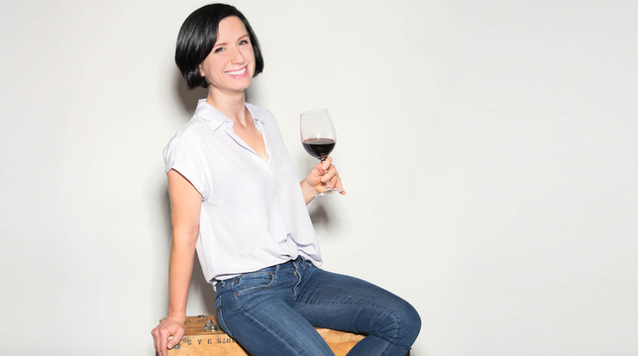

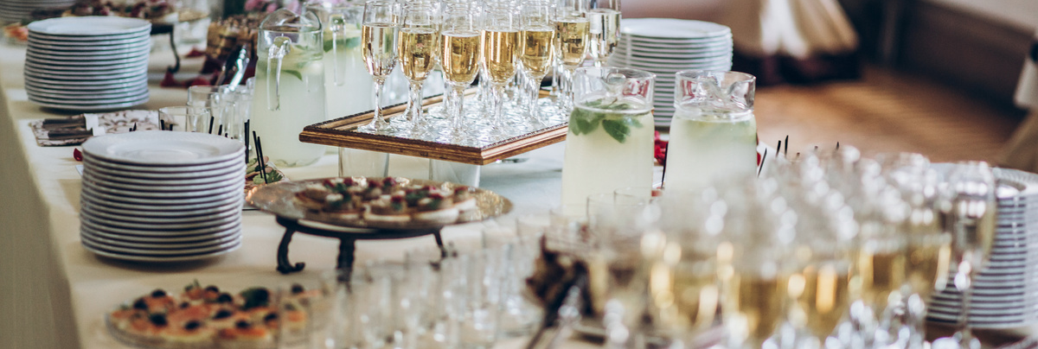
MAGNIFIQUE LUX WINES IS ONLINE AND IN-STORE!
Instagram Lives with Madeline Puckette
TikTok Demonstrations with The Wine Guru
Email Newsletters & Brochures
Store-Front Events
Expand to More Audiences
Gain a New Following
Weekly Consumer Reach
Forming Bonds and Connections
Magnifique Lux Wines has found a great way to engage both new and old customers by utilizing the services of American influencer Madeline Puckette. Puckette has built her brand, “The Wine Folly,” around showcasing various wine brands, their production process, store locations, and more. Her expertise in the wine industry has helped educate and inform Magnifique Lux Wines' customers locally and internationally, thereby increasing the brand's reach.
Subscribe to our weekly newsletter and download the exclusive Magnifique Lux Wines brochure. This will not only prepare you for an exciting experience when you shop online and in-store, but it will also provide you with information about new wine bottle and flavor launches, upcoming events, pop-up shops, collaborations with your favorite wine educators, and much more. Don't miss out on the latest updates and trends in the world of Magnifique Lux Wines!
If you're looking for an epic wine-tasting experience, stop by our new store opening in the capital of Tbilisi. At Magnifique Lux Wines, we offer everything from wine-tasting events, bridal and groom showers, and casual gatherings to touring our little production area. We welcome both new and experienced wine lovers to come and explore.
The Wine Guru is an avid wine lover on TikTok who is always ready to have fun, educate, and, most importantly, drink! With over 218.2k followers, The Wine Guru provides a unique perspective on purchasing the best wine, where to buy it, and how to market your brand. Following The Wine Guru is an excellent and entertaining way to reach domestic and global wine consumers.
Magnifique Lux Wines
Notes:
Magnifique Lux Wines takes pride in producing and marketing our wines ourselves. We use various social media platforms, such as Instagram and TikTok, and email marketing tactics, like newsletters and brochures. Our online and in-store wedding packages offer the sweet-smelling allure of happily ever after—all in a glass of white or red wine.
The team of wine connoisseurs at Magnifique Lux Wines is confident that our collaborations with Instagram wine educators like Wine Folly's Madeline Puckette, TikTok influencers like The Wine Guru, specialists like Georgia-born Daria Kholodilina, and even Georgia-based restaurants, will help our wine reach millions.
When a company markets its products or services in a new culture, it needs to establish a routine that is easy to follow, share, and teach to others (Cardon, 2021, p. 58). Our digital marketing strategy for Georgian culture and cuisine focuses on pasta, decadent chocolates, grapes, and other produce. We have partnered with Instagram and TikTok influencers to reach out to wine enthusiasts who love to share the latest wine ingredients and wine-based food recipes with their followers. We also organize in-store events such as wine-tasting, bridal and groom showers, and educational classes to attract new customers. With these efforts, Magnifique Lux Wines will surely market itself in a new and vibrant way.

Slide 8

Connect With Us!
WEBSITE
www.magnifiqueluxwines.com
TIKTOK
@magnifiqueluxwines
INSTAGRAM
@magnifiqueluxwines
Notes:
In a global, competitive industry like wine, a company must be unique and informative for new and experienced consumers. Marketing to the culture and livelihood of Georgia wine lovers means incorporating the U.S. roots of wine into a newer experience of education, communication, and customer loyalty (ikono Wine Consulting, 2023).
Our company's mission is to perfect the flavor of our red and white wines and prioritize sustainability and dietary friendliness. At Magnifique Lux Wines, we cater to all backgrounds, languages, and cultures—young and old, men and women—who appreciate fine dining, exciting events, and the sweet taste of delicious wine. Our wines are perfect for any occasion, whether brunch at 1 pm or dinner at 9 pm.
Now, with our 24/7 online operations and grand store opening in the beautiful city of Tbilisi, Georgia, Georgians can get an exclusive peek at Magnifique Lux Wines, an affordable, sustainable, and luxurious company. We are here to give sweetness, juiciness, and, most importantly, smiles with every sip.

Slide 9
REFERENCE PAGE
  Cardon, P. W. (2021). Business communication: Developing leaders for a networked world (4th ed.). McGraw-Hill Higher Education.
  Learn about wine. Wine Folly. (n.d.). https://winefolly.com/
  Network, C. L. (n.d.). Understanding the worldviews of others. Collaborative Leaders Network. https://collaborativeleadersnetwork.org/strategy-tools/understanding-the-worldviews-of-others
  Pop, A.-M., & Sim, M.-A. (2022). Cross-Cultural Communication in Multinational Companies. Annals of the University of Oradea, Economic Science Series, 31(1), 324–332. https://doi-org.ezproxy.snhu.edu/10.47535/1991auoes31(1)031
  The Wine Guru LLC: Wine Tasting: Appleton, Wisconsin, USA. The Wine Guru. (n.d.). https://www.thewineguru.net/
  Wine marketing strategy: Unearthing the secrets of successful branding. Ikono. (2023, September 2). https://ikono.org/wine/
  Winetraveler, L., & Levine, A. (2023, December 14). Ultimate Guide to georgian wine country: Kakheti & tbilisi. Winetraveler. https://www.winetraveler.com/georgia/ultimate-guide-to-georgian-wine-country-best-of-kakheti-and-tbilisi/#:~:text=Georgia%E2%80%99s%20winemaking%20heritage%20is%20deeply%20rooted%20in%20its,of%20these%20varieties%20actively%20cultivated%20in%20commercial%20viticulture.

Slide 10
Thank You.

